Slide 1
Robotics and AI Department
ETHAR ABDULAZIZ MOHAMEED ALZAHRANI

Slide 2

INTRODUCTION
Robots have become a topic of great interest nowadays. In our imagination, a robot is a machine that looks and behaves like a human being. Robots are, in fact, defined as human-made mechanical devices that can move on their own, their movement must be designed, planned, sensed, pushed and controlled, and their kinetic behavior can be influenced by “programming”.

Slide 3
—STEVE JOBS
“Sometimes life is going to hit you in the head with a brick. Don't lose faith.”

Slide 4
01
03
02
04
What does SLAM mean?
Use Turtlebot3 with SLAM approach to create and
save a map
TURTLEBOT3
Use another ROS robot whit SLAM approach to create and save a map

Slide 5
01
SLAM

Slide 6


SLAM mean
SLAM as abbreviation means "Simultaneous Localization and Mapping".
https://en.wikipedia.org/wiki/Simultaneous_localization_and_mapping

Slide 7
02
TURTLEBOT3

Slide 8
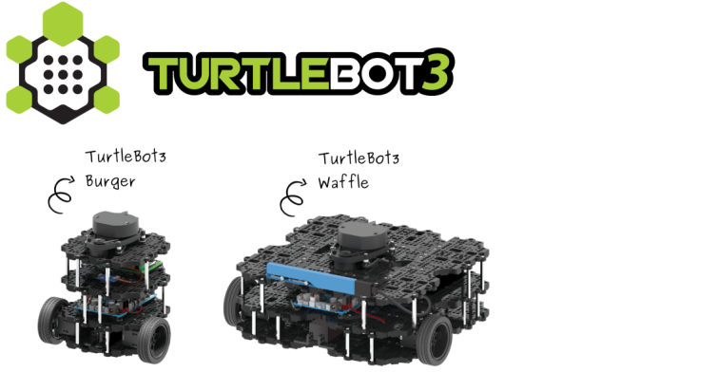
TURTLEBOT3
https://emanual.robotis.com/docs/en/platform/turtlebot3/quick-start/

Slide 9
Turtlebot3
Turtlebot3
Turtlebot3
Burger
Waffle

Slide 10
Turtlebot3 Burger

Slide 11
Type in the commands down below in the terminal
Install ROS 1 on Remote PC 3. 1. 2
$ sudo apt update
$ sudo apt upgrade
$ wget https://raw.githubusercontent.com/ROBOTIS-GIT/robotis_tools/master/install_ros_melodic.sh
$ chmod 755 ./install_ros_melodic.sh
$ bash ./install_ros_melodic.sh
Install Dependent ROS 1 Packages 3. 1. 3
$ sudo apt-get install ros-melodic-joy ros-melodic-teleop-twist-joy \
ros-melodic-teleop-twist-keyboard ros-melodic-laser-proc \
ros-melodic-rgbd-launch ros-melodic-depthimage-to-laserscan \
ros-melodic-rosserial-arduino ros-melodic-rosserial-python \
ros-melodic-rosserial-server ros-melodic-rosserial-client \
ros-melodic-rosserial-msgs ros-melodic-amcl ros-melodic-map-server \
ros-melodic-move-base ros-melodic-urdf ros-melodic-xacro \
ros-melodic-compressed-image-transport ros-melodic-rqt* \
ros-melodic-gmapping ros-melodic-navigation ros-melodic-interactive-markers

Slide 12
Type in the commands down below in the terminal
Install TurtleBot3 Packages 3. 1. 4
$ sudo apt-get install ros-melodic-dynamixel-sdk
$ sudo apt-get install ros-melodic-turtlebot3-msgs
$ sudo apt-get install ros-melodic-turtlebot3
Enter these codes in the terminal to install Simulation packages
Simulation Install 6. 1. 1
$ cd ~/catkin_ws/src/
$ git clone -b melodic-devel https://github.com/ROBOTIS-GIT/turtlebot3_simulations.git
$ cd ~/catkin_ws && catkin_make
new terminal after the 3rd step
After you are done type in this command in the terminal
$ source ~/catkin_ws/devel/setup.bash
JUST COPY (ctrl+c) and PASTE (ctrl+v) in Terminal

Slide 13
Type in the commands down below in the terminal
Run these commands in the terminal to launch the simulation world.
Launch Simulation World
$ export TURTLEBOT3_MODEL=burger
$ roslaunch turtlebot3_gazebo turtlebot3_world.launch
Run these commands in the terminal to launch the SLAM Node.
Run SLAM Node
$ export TURTLEBOT3_MODEL=burger
$ roslaunch turtlebot3_slam turtlebot3_slam.launch slam_methods:=gmapping
Run this command to be able to interact and control the robot
Run Teleoperation Node
$ export TURTLEBOT3_MODEL=burger
$ roslaunch turtlebot3_teleop turtlebot3_teleop_key.launch
JUST COPY (ctrl+c) and PASTE (ctrl+v) in Terminal

Slide 14
Type in the commands down below in the terminal
Now you should be able to control the robot using the keys WASDX to roam around the gazebo simulated map.
After you are done exploring the map with your robot you should save
more information visit this website
https://emanual.robotis.com/docs/en/platform/turtlebot3/quick-start/

Slide 15
03
create and save a map

Slide 16
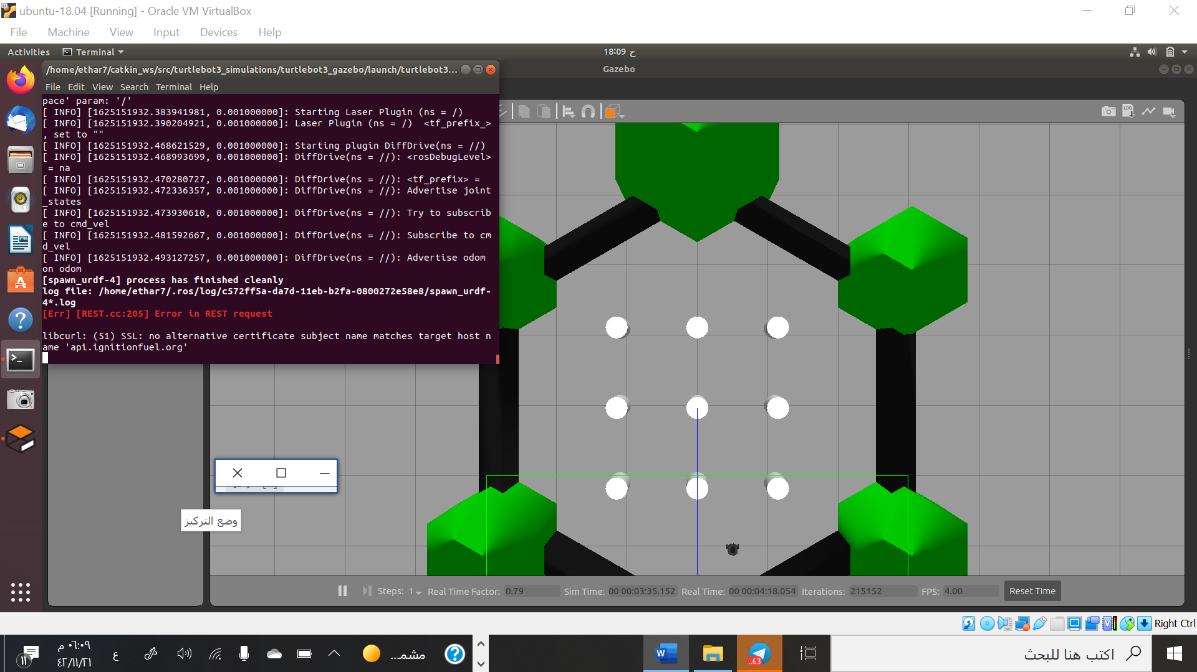
Gazebo

Slide 17
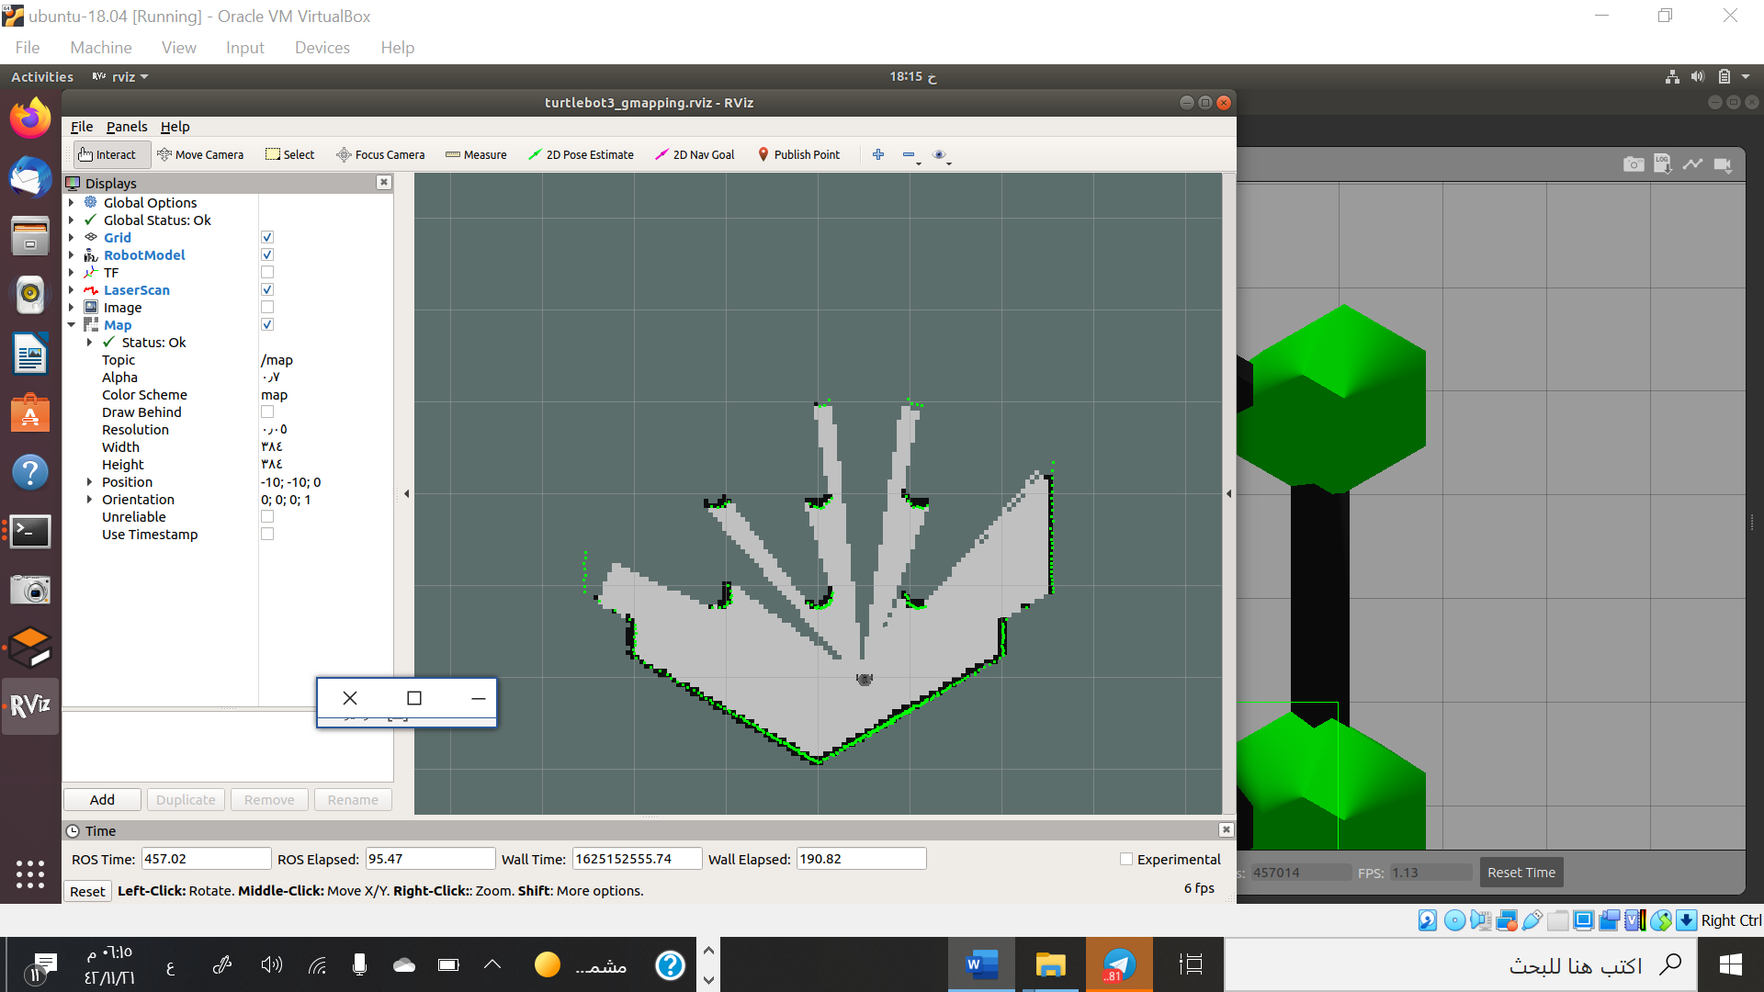
The map before move the robot

Slide 18
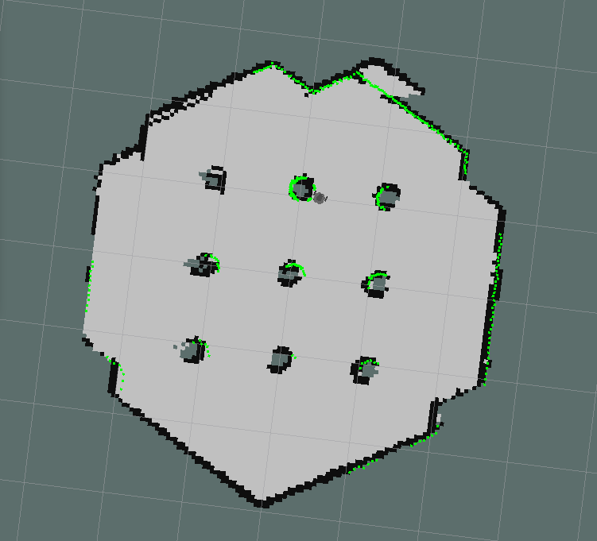
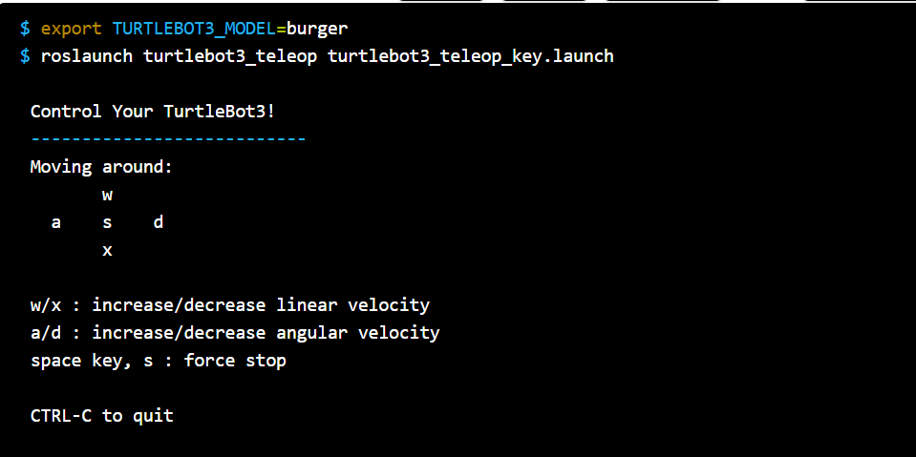
control the robot

Slide 19

To save the map using
(Ctrl + Alt + T)
Or
$ rosrun map_server map_saver -f ~/map

Slide 20
04
Use another ROS robot whit SLAM approach to create and save a map

Slide 21
This ROS package implements SLAM on a 2 wheeled differential drive robot to map an unknown environment. A joystick is used to teleoperate the robot in Gazebo. The map generated is then used for autonomous navigation using the ROS Navigation stack.

Slide 22

Type in the commands down below in the terminal
Build package from source: navigate to the source folder of your catkin workspace and build this package using:
$ git clone https://github.com/devanshdhrafani/diff_drive_bot.git
$ cd ..
$ catkin_make
Install Required dependencies:
$ sudo apt-get install ros-melodic-dwa-local-planner
$ sudo apt-get install ros-melodic-joy
Load the robot in the Gazebo environment:
$ roslaunch diff_drive_bot gazebo.launch
Launch the slam_gmapping node. This will also start rviz where you can
visualize the map being created:
$ roslaunch diff_drive_bot gmapping.launch
using keyboard:
$ rosrun diff_drive_bot keyboard_teleop.py
Save the map using:
$ rosrun map_server map_saver -f ~/test_map
JUST COPY (ctrl+c) and PASTE (ctrl+v) in Terminal

Slide 23
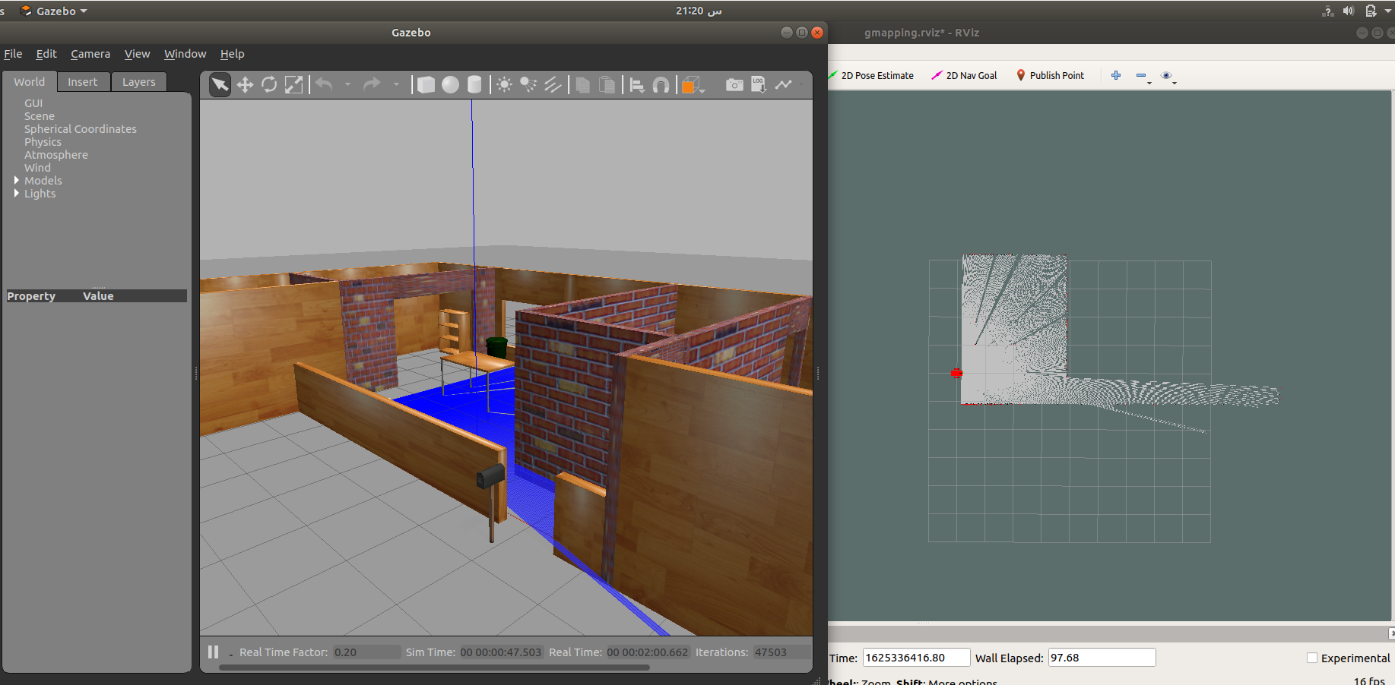
Now open the Gazebo and Rviz

Slide 24
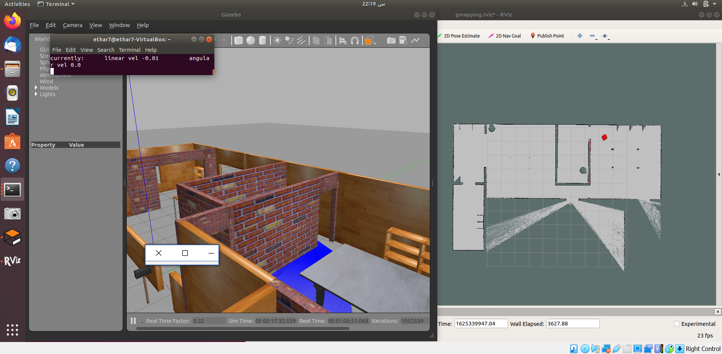
The finally map

Slide 25
THANK YOU!
for giving me your time to watch the show.
I hope you enjoy.

